Slide 1
Key Drivers of Restaurant Success in Santa Barbara: 2019-2021
Stat 628 - Module 3
Jinwen Xu, Yu Luan, Ruotong Zhang

Slide 2
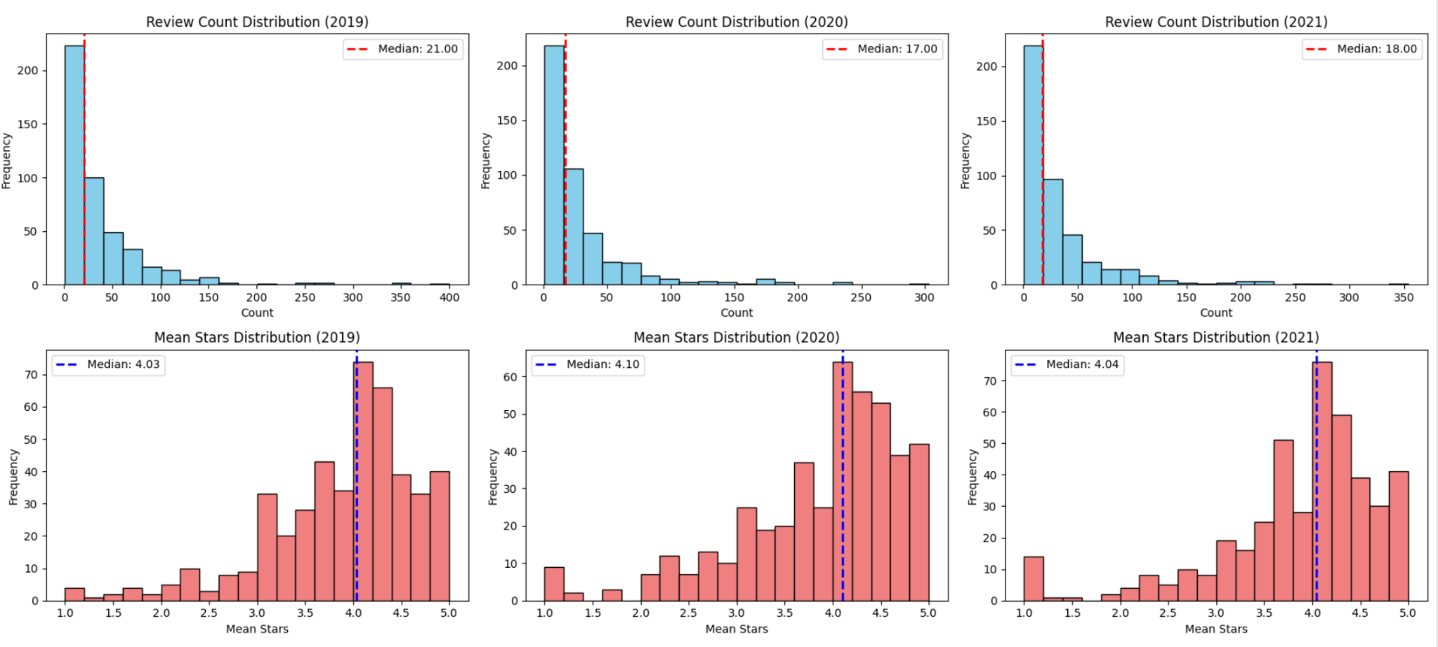
Constructing Metrics to Assess Business Success
1.Distribution of The average star rating and review count for each restaurant annually
2.Creating clear metrics to define successful restaurants.
Conditions: Star Rating > Median Star Rating & Review Count > Median Review Count (annual)
Data source: business.json,review.json from Yelp

Slide 3
Selection of Predictors
1.Selection Criteria
(1). Variables should not have a high number of missing values, which reduces the amount of effective information and leads to significant analysis errors.
(2). The values of the variables should be as balanced as possible; if most of a variable's values belong to one category, it can lead to sample imbalance and large analysis errors
2.Selection Outcomes
(1) Average annual household income after normalization.
(2)Restaurant price range (ranges from 0 to 4, with larger values representing a wider price range)
(3)Restaurant table service (Binary data, with 1 representing the presence of restaurant service)
(4)Quiet Level (ranges from 0 to 3, with higher values indicating a quieter environment)

Slide 4


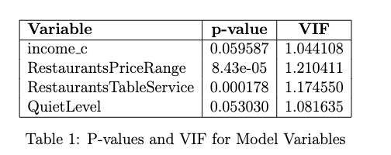
Model Construction
1. Multivariate Logistic Regression Model
Where Y=1 means that the restaurant was successful that year,
=0.136*Income + 0.467* RastaurantsPriceRange +0.563*RastaurantsTableService +0.183 *QuietLevel
2. Coefficient Analysis

Slide 5
Shiny App
link:https://jinwen626.shinyapps.io/STAT628Yelp/

Slide 6
Strengths and Limitations
1.Strengths
(1). We used data from multiple sources to explore the factors contributing to restaurant success from various perspectives, including the restaurant’s own attributes and economic impacts.
(2). Based on previous analyses, we observed significant temporal variations in the data. Therefore, we analyzed annual average and total data, rather than averaging over the three years.
(3). By effectively filtering and encoding variables, we reduced the number of variables before building the model, greatly facilitating subsequent modeling.
(4). We established an appropriate model based on the nature of the data, and the p-values indicate that the chosen independent variables have a significant impact on the dependent variable
2. Limitations
In analyzing the key drivers of Santa’s restaurant success, we utilized data from multiple sources. Consequently, we filtered out data common to these sources, thereby reducing the overall amount of data.

Slide 7
Suggestions and Conclusions
1. Operate in High-Income Areas: Focus on establishing and operating your restaurant in high-level-income areas.
2. Expand price range and offer more choices: In order to achieve higher ratings and attract more people to your restaurant, consider expanding your pricing strategy to offer more choices.
3. Improve the quality of table service and create a quiet dining environment: Improving the quality of table service is critical to increasing customer satisfaction. It's also beneficial to ensure a quiet dining environment, as our modeling shows that restaurants with higher levels of quiet tend to be more successful.

